Slide 1
The Economics of Mobile Gaming: Analysing the Highest-Grossing Mobile Games of All Time
Exploring growth, revenue, and consumer trends
By: Ace pagaddu Course : Code Institute – Individual Project Tools: Python, Pandas, NumPy, Matplotlib, Seaborn, Jupyter Notebook Dataset: Kaggle (Highest Grossing Mobile Games)
Notes:
AI-generated content may be incorrect. --- This presentation explores the economic dynamics of mobile gaming, focusing on the highest-grossing titles. We will examine the industry's growth, revenue models, successful case studies, consumer behaviour, and the economic impact alongside future trends shaping the sector.

Slide 2
Project Overview:
What This Project Explores
The mobile gaming industry generates more revenue than film and music combined — but only a handful of titles reach global dominance.
This project investigates:
What makes certain mobile games achieve extreme financial success
Which genres and publishers dominate global markets
What patterns separate average performers from multi-billion-dollar franchises
How release timing, publisher influence, and genre economics shape outcomes
Notes:
We will begin with an overview of the mobile gaming industry, followed by an examination of revenue models used. Next, we will review case studies of the top-grossing games, analyse consumer behaviour and spending patterns, and conclude with the economic impact and future trends in mobile gaming.

Slide 3
RESEARCH OBJECTIVES:
Primary Question
What economic, structural, and publishing factors define the top-earning mobile games of all time?
🔍 Sub-objectives
Analyse revenue patterns
Compare performance across genres
Identify top publishers
Understand lifespan and release-year trends
Evaluate what makes “mega-hit” games financially resilient
Notes:
Mobile gaming has seen exponential growth with a diverse global audience. This section covers the industry's expansion, demographics of users, and the primary platforms and distribution channels that dominate the market.

Slide 4

DATASET SUMMARY:
📊 Dataset: Highest Grossing Mobile Games (Kaggle)
Rows : 100
Columns : 12
Primary Fields : - Game Name - Publisher - Release Year - Lifetime Revenue - Genre - Platform Availability
📥 Data Source:
Kaggle Public Dataset (https://github.com/acepag/AP---Code-Institute---Individual-Project-2025-/blob/main/README.md)
Notes:
--- Mobile gaming has become one of the fastest-growing entertainment sectors worldwide, reaching billions of users. Its accessibility through smartphones has enabled unprecedented global penetration, making it a dominant force in digital entertainment. Image source: Microsoft 365 content library

Slide 5

DATA CLEANING & PREPARATION:
🧹 ETL Steps Completed
- Removed duplicate rows
- Checked for missing values
- Standardised column names
- Converted revenue to numerical format
- Extracted release_year feature
- Cleaned genre labels for consistency
- Verified dataset integrity
🏗 Goal
- Ensure the dataset is accurate, consistent, and ready for analysis.
Notes:
--- The mobile gaming audience spans all age groups and genders, with notable growth in emerging markets. Understanding user statistics helps identify target segments crucial for game development and marketing strategies. Image source: Microsoft 365 content library

Slide 6

EXPLORATORY DATA ANLYSIS: (EDA)
🔍 Key EDA Components
- Revenue distribution analysis
- Top-10 highest earning games
- Publisher and genre frequency
- Release year clustering
- Revenue vs. Release Year scatter
📈 Approach
- Reveal patterns that explain: - Which games earn the most? - Who are the top publishers? - Which genres lead revenue? - How timing affects earning potential?
Notes:
--- Major platforms include Android and iOS, with app stores like Google Play and Apple’s App Store serving as primary distribution channels. These platforms shape user experience and monetisation options. Image source: Microsoft 365 content library

Slide 7
Visual INSIGHTS:
📊 Recommended visuals to include:
- Top 10 Highest-Grossing Games (bar chart)
- Genre Distribution (pie / bar chart)
- Publisher Revenue Contribution
- Release Year vs Revenue Scatter
- Revenue Distribution Histogram
- These visuals highlight the strongest patterns in your dataset.
Notes:
This section explores the various monetisation strategies mobile games employ, including freemium models, advertising, sponsorships and subscription services driving revenue generation.

Slide 8
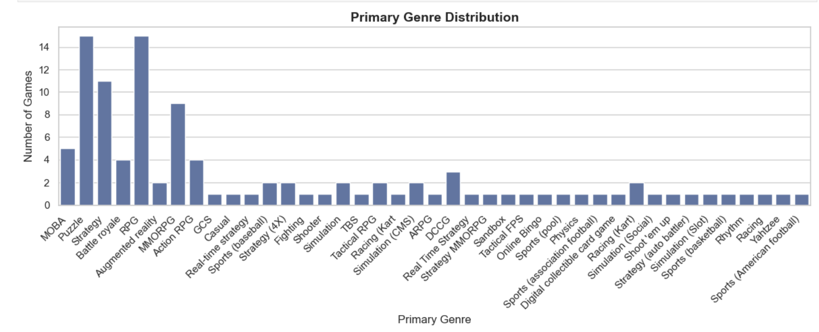
Visual INSIGHTS:
Notes:
This section explores the various monetisation strategies mobile games employ, including freemium models, advertising, sponsorships and subscription services driving revenue generation.

Slide 9
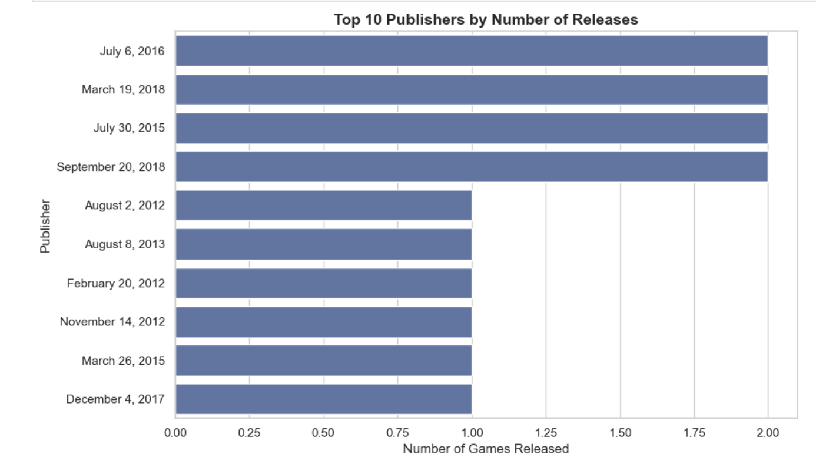
Visual INSIGHTS:
Notes:
This section explores the various monetisation strategies mobile games employ, including freemium models, advertising, sponsorships and subscription services driving revenue generation.

Slide 10
KEY FINDINGS:
⭐ 1. Publisher Dominance
A small cluster of powerful publishers (Tencent, Supercell, Nintendo) generate the majority of global mobile gaming revenue.
⭐ 2. Genre Economics
Genres such as Gacha, MOBA, and Battle Royale significantly outperform others in lifetime earnings.
⭐ 3. Release Timing Matters
Games launched between 2011 and 2016 dominate lifetime revenue, proving the value of early mobile market entry.
Notes:
--- The freemium model offers the game for free while monetising through optional in-app purchases. This approach encourages wide adoption while generating significant revenue from engaged players buying virtual goods or enhancements. Image source: Microsoft 365 content library

Slide 11

LIMITATIONS:
⚠ Important to Acknowledge
- Dataset focuses only on top-earning games, not the full market
- Revenue data may contain approximations
- Limited granularity (no monthly/yearly breakdown)
- Some genres overlap
- Platform / region-specific effects not fully captured
Notes:
--- Many games incorporate ads or brand sponsorships, balancing user experience with revenue. Techniques include rewarded videos, interstitial ads, and branded content partnerships to monetise free-to-play users. Image source: Microsoft 365 content library

Slide 12

NEXT STEPS:
🔮 Future Improvements
- Add full-market dataset to compare average vs top-earning games
- Cluster analysis on genre & gameplay structure
- Predictive modelling (e.g., estimate revenue drivers)
- Expand dataset with user-ratings and retention metrics
- Build an interactive dashboard with Plotly or PowerBI
Notes:
--- Subscription models offer players regular content, bonuses, or ad-free experiences for a recurring fee, providing predictable revenue streams and deeper player retention. Image source: Microsoft 365 content library

Slide 13

CONCLUSION:
🧠 Final Summary
This project demonstrates how data can reveal the invisible mechanics of economic success in mobile gaming. By analysing revenue, publishers, genres, and release timing, we identify what separates short-lived titles from multi-billion-dollar phenomena.
Mobile gaming is not random — it follows clear economic patterns. This notebook uncovers them.
Notes:
--- These titles have achieved remarkable financial success through engaging gameplay, strong community building and effective monetisation strategies tailored to their audiences. Image source: Microsoft 365 content library

Slide 14

THANK YOU!
🙏 Thank you for reviewing my project.
If you have any questions, I would be happy to explain any part of the analysis.
Notes:
--- Strategies include in-app purchases, seasonal events, cosmetic customisations, and targeted advertising, allowing games to maximise player spending without compromising engagement. Image source: Microsoft 365 content library

